Slide 1
DASHBOARD IN A DAY
Vasim Shaikh
Day 3
Accenture

Slide 2
A Quick Recap
1
Lets get our feet wet!

Slide 3
Shortcut & Structure
Shine {tab}
library(shiny)
ui <- fluidPage()
server <- function(input, output, session){}
shinyApp(ui = ui, server = server)

Slide 4
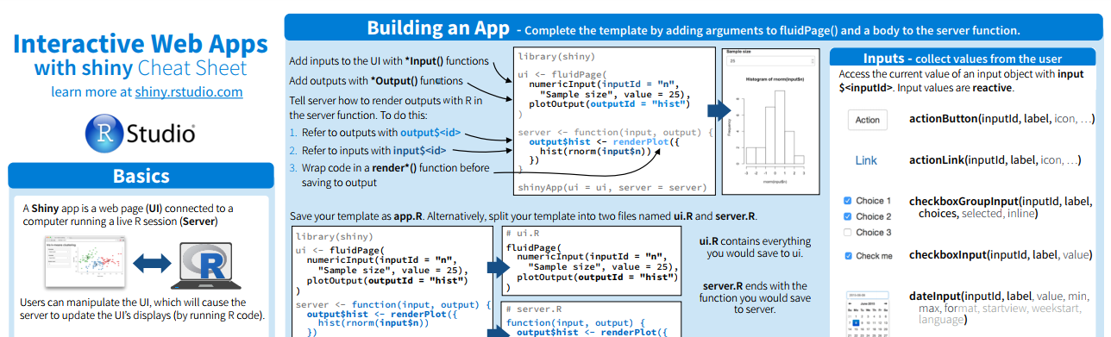
Shiny Cheatsheet
http://shiny.rstudio.com/images/shiny-cheatsheet.pdf

Slide 5
Shiny Input Elements
ActionButton
ActionLink
DateInput
DateRangeInput
etc…
*Inputs does not have an output result
They have an inputid argument
Directly visible on dashboard

Slide 6
Shiny Output Elements
Define *output id in UI
Assign render* to output < id > in server
Chart / Plot
Table
Text
HTML
etc

Slide 7
Lets Make our Inputs reactive
Use input in server

Slide 8
BASIC
APP
Lets create one!

Slide 9

Shiny Layout
SidebarLayout
SidebarPanel
MainPanel
Notes:
https://shiny.rstudio.com/articles/layout-guide.html

Slide 10
Dashboard Layout
fluidRow(
column(width = 2, plotoutput(“id”)))
Width is equal to 12
Other types of layout

Slide 11
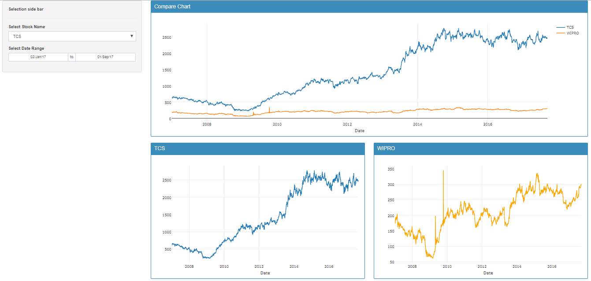
Want big impact?
USE BIG IMAGE.
MORE ON LAYOUT

Slide 12
Add External files
IncludeCSS()
IncludeScript()
IncludeMarkdown()
IncludeHTML()
Inside fuidPage()

Slide 13
Navigation bar Layout
navbarPage
tabPanel
navbarMenu (grouped tabPanel)
HELP

Slide 14
Add a Table to our Dashboard
Library(DT)

Slide 15
Reactivity 2.0
ObserveEvent
ReactiveEvent

Slide 16
External Reactivity DEMO APP
Refresh on click

Slide 17
BASIC CSS
CSS cheat sheet

Slide 18
Additional components
Notification
KPI Boxes
Icons
Loading Chart – shinycssloader
Collapse boxes

Slide 19
Shiny Dashboard

Slide 20
Share your dashboard
2.
Showcase your skills!

Slide 21
Share on Windows
By IP address
By Sharing Code

Slide 22
Share via Shiny Server
Lets create a free Ubuntu server on DigitalOcean
A card is required for registration
Destroy server to avoid payments
A one time setup, usually performed by IT
But we should be aware of procedures
HELP

Slide 23
IMPORTANT PATH AND DOCUMENTS OF SHINY SERVER
Shiny server log
“srv” folder

Slide 24
Shiny Server
Apps in “srv” folder run as shiny user
To write a file provide write access

Slide 25
Share via Shinyapps.io
Upload application

Slide 26
DEMO Dashboard
3.
Lets Dive in!

Slide 27
BUSINESS INTELLIGENCE
HR
FINANCE
SALES

Slide 28
Password Protected App
Share code

Slide 29
Google ID protected
Google ID

Slide 30
INSTRUCTIONS FOR USE
EDIT IN GOOGLE SLIDES
Click on the button under the presentation preview that says "Use as Google Slides Theme". You will get a copy of this document on your Google Drive and will be able to edit, add or delete slides. You have to be signed in to your Google account.
EDIT IN POWERPOINT®
Click on the button under the presentation preview that says "Download as PowerPoint template". You will get a .pptx file that you can edit in PowerPoint.
Remember to download and install the fonts used in this presentation (you’ll find the links to the font files needed in the Presentation design slide)
More info on how to use this template at www.slidescarnival.com/help-use-presentation-template
This template is free to use under Creative Commons Attribution license. You can keep the Credits slide or mention SlidesCarnival and other resources used in a slide footer.

Slide 31

HELLO!
I am Jayden Smith
I am here because I love to give presentations.
You can find me at @username

Slide 32
TRANSITION HEADLINE
1.
Let’s start with the first set of slides

Slide 33
Quotations are commonly printed as a means of inspiration and to invoke philosophical thoughts from the reader.

Slide 34
THIS IS A SLIDE TITLE
Here you have a list of items
And some text
But remember not to overload your slides with content
Your audience will listen to you or read the content, but won’t do both.

Slide 35
BIG
CONCEPT
Bring the attention of your audience over a key concept using icons or illustrations

Slide 36
YOU CAN ALSO SPLIT YOUR CONTENT
White
Is the color of milk and fresh snow, the color produced by the combination of all the colors of the visible spectrum.
Black
Is the color of coal, ebony, and of outer space. It is the darkest color, the result of the absence of or complete absorption of light.

Slide 37
IN TWO OR THREE COLUMNS
Yellow
Is the color of gold, butter and ripe lemons. In the spectrum of visible light, yellow is found between green and orange.
Blue
Is the colour of the clear sky and the deep sea. It is located between violet and green on the optical spectrum.
Red
Is the color of blood, and because of this it has historically been associated with sacrifice, danger and courage.

Slide 38
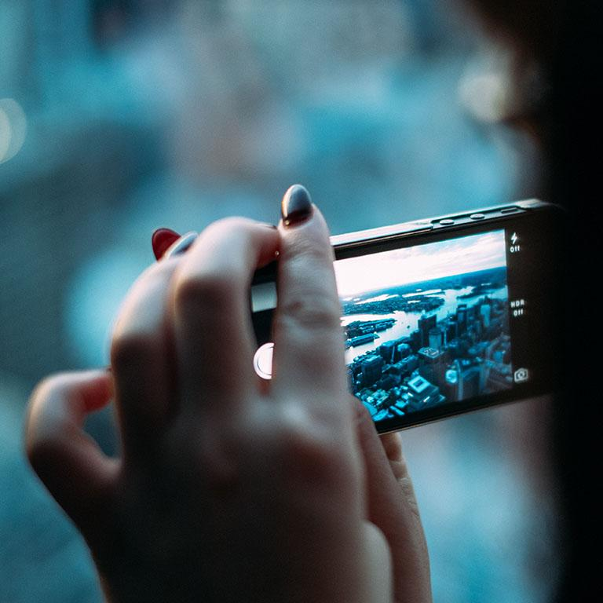
A PICTURE IS WORTH A THOUSAND WORDS
A complex idea can be conveyed with just a single still image, namely making it possible to absorb large amounts of data quickly.

Slide 39
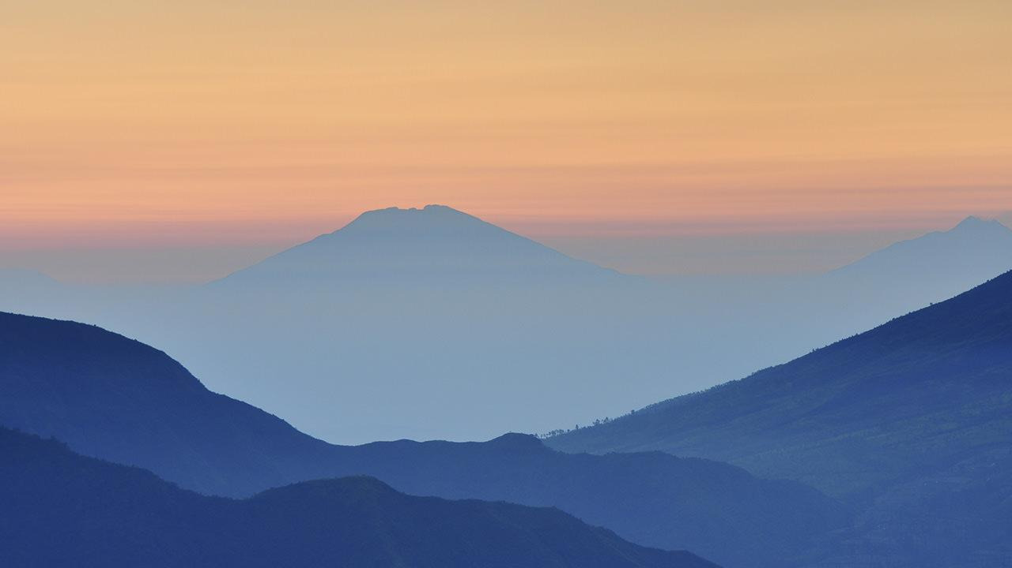
Want big impact?
USE BIG IMAGE.

Slide 40
USE CHARTS TO EXPLAIN YOUR IDEAS
White
Gray
Black

Slide 41
AND TABLES TO COMPARE DATA
 | A | B | C
Yellow | 10 | 20 | 7
Blue | 30 | 15 | 10
Orange | 5 | 24 | 16

Slide 42
MAPS
our office

Slide 43
89,526,124
Whoa! That’s a big number, aren’t you proud?

Slide 44
89,526,124$
185,244 users
100%
That’s a lot of money
And a lot of users
Total success!

Slide 45
OUR PROCESS IS EASY
first
second
last

Slide 46
Let’s review some concepts
Yellow
Is the color of gold, butter and ripe lemons. In the spectrum of visible light, yellow is found between green and orange.
Blue
Is the colour of the clear sky and the deep sea. It is located between violet and green on the optical spectrum.
Red
Is the color of blood, and because of this it has historically been associated with sacrifice, danger and courage.
Yellow
Is the color of gold, butter and ripe lemons. In the spectrum of visible light, yellow is found between green and orange.
Blue
Is the colour of the clear sky and the deep sea. It is located between violet and green on the optical spectrum.
Red
Is the color of blood, and because of this it has historically been associated with sacrifice, danger and courage.

Slide 47
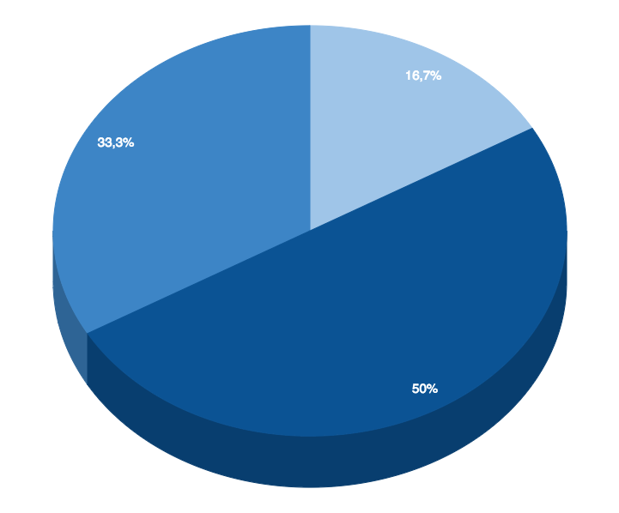
You can insert graphs from Google Sheets

Slide 48
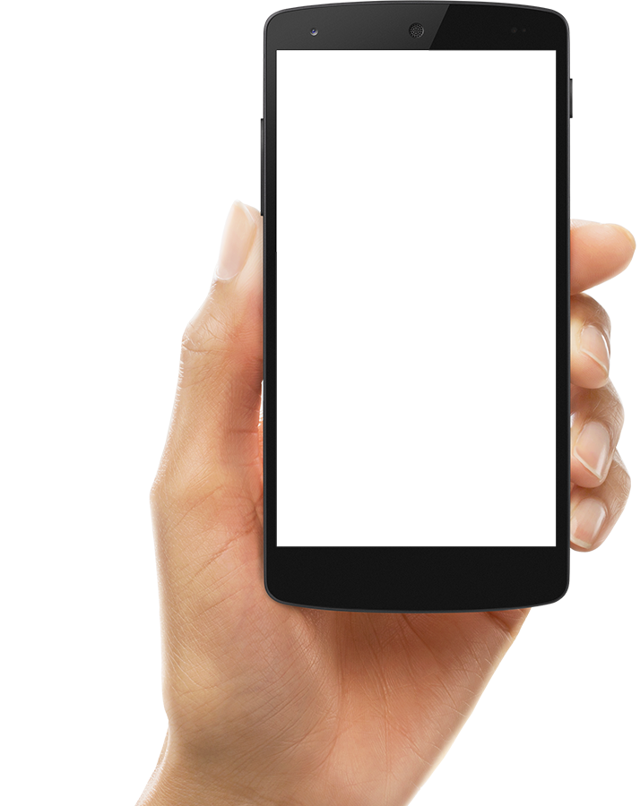
ANDROID PROJECT
Show and explain your web, app or software projects using these gadget templates.

Slide 49
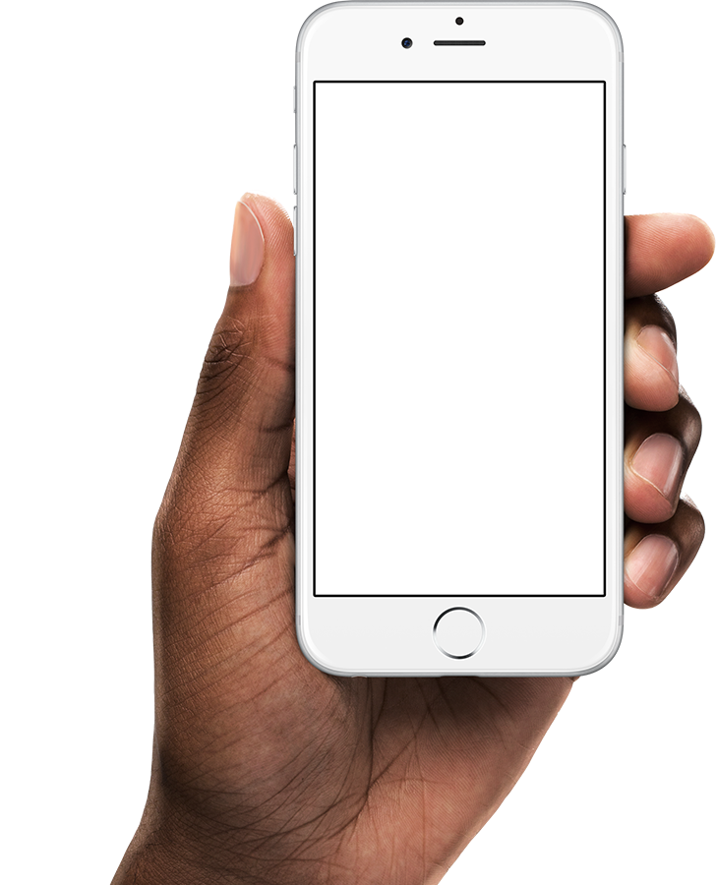
iPHONE PROJECT
Show and explain your web, app or software projects using these gadget templates.

Slide 50
Place your screenshot here
TABLET PROJECT
Show and explain your web, app or software projects using these gadget templates.

Slide 51
Place your screenshot here
DESKTOP PROJECT
Show and explain your web, app or software projects using these gadget templates.

Slide 52
THANKS!
Any questions?
You can find me at:
@username
user@mail.me

Slide 53
CREDITS
Special thanks to all the people who made and released these awesome resources for free:
Presentation template by SlidesCarnival
Photographs by Unsplash
Diverse device hand photos by Facebook Design Resources

Slide 54
PRESENTATION DESIGN
This presentation uses the following typographies and colors:
Titles: Montserrat
Body copy: Source Sans Pro
You can download the fonts on these pages:
https://www.fontsquirrel.com/fonts/montserrat
https://www.fontsquirrel.com/fonts/source-sans-pro
Sky Blue #00bef2 / Navy Blue #25516c
You don’t need to keep this slide in your presentation. It’s only here to serve you as a design guide if you need to create new slides or download the fonts to edit the presentation in PowerPoint®

Slide 55
SlidesCarnival icons are editable shapes.
This means that you can:
Resize them without losing quality.
Change fill color and opacity.
Change line color, width and style.
Isn’t that nice? :)
Examples:

Slide 56
😉
Now you can use any emoji as an icon!
And of course it resizes without losing quality and you can change the color.
How? Follow Google instructions https://twitter.com/googledocs/status/730087240156643328
✋👆👉👍👤👦👧👨👩👪💃🏃💑❤😂😉😋😒😭👶😸🐟🍒🍔💣📌📖🔨🎃🎈🎨🏈🏰🌏🔌🔑 and many more...

